Slide 1
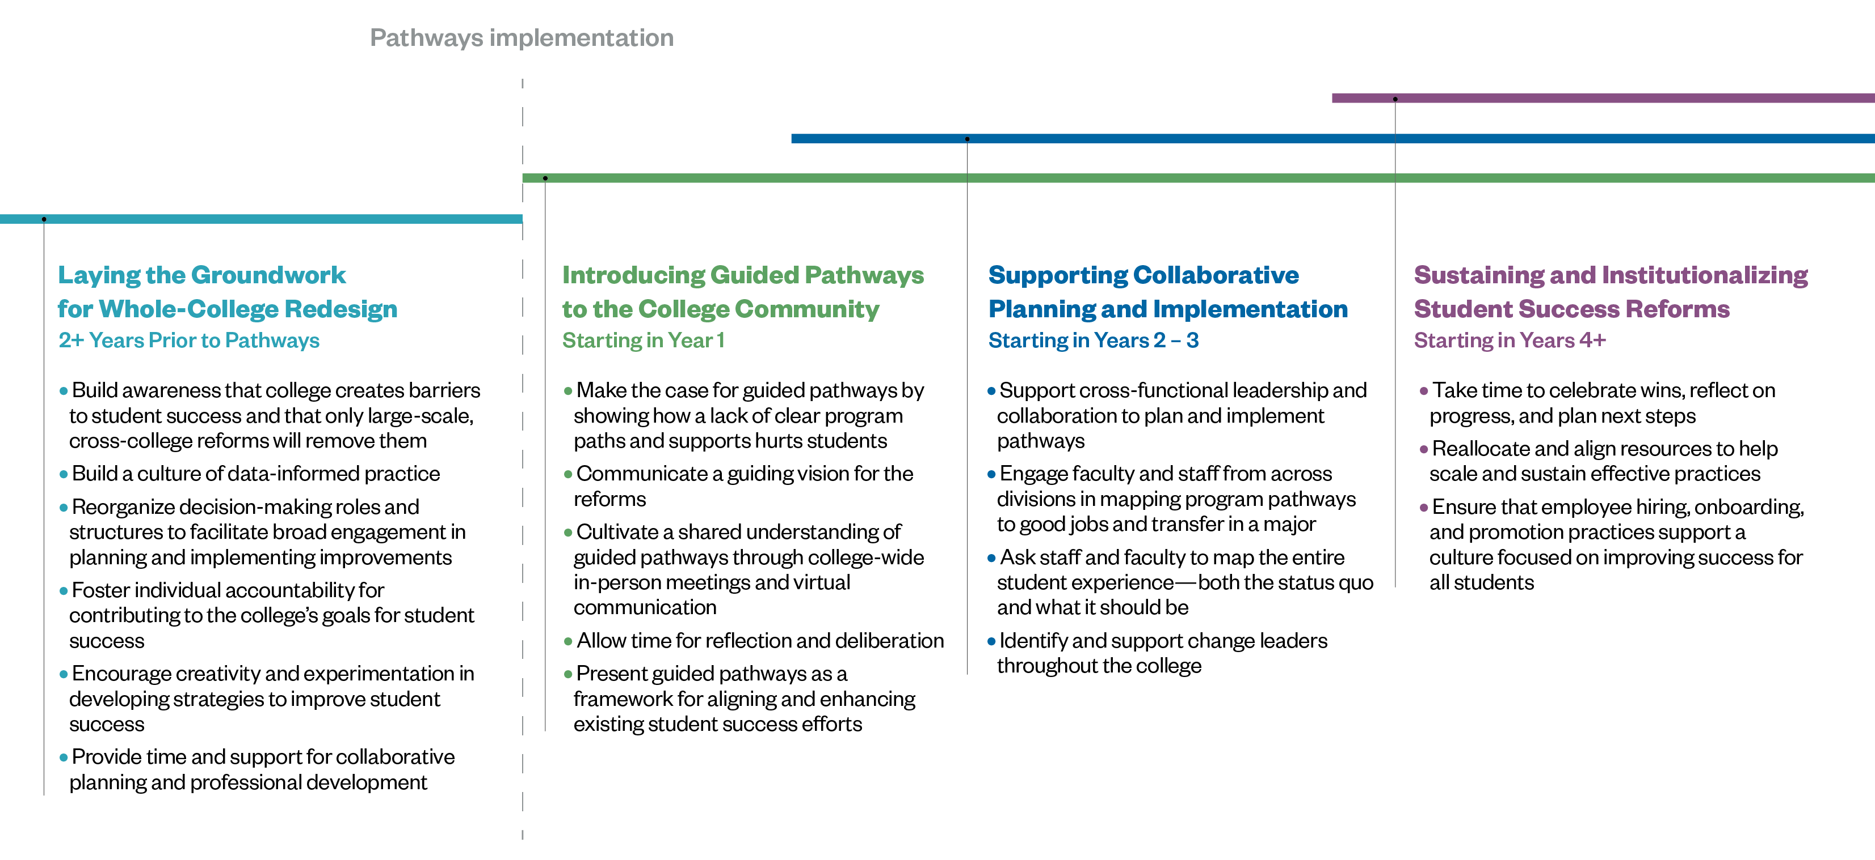
Timeline and Strategies for Leading Guided Pathways Redesigns
Jenkins, D., Lahr, H., Brown, A. E., & Mazzariello, A. (2019). Redesigning your college through guided pathways: Lessons on managing whole-college reform from the AACC Pathways Project. New York, NY: Columbia University, Teachers College, Community College Research Center.

