Slide 1
“A Unified Front”: Understanding Holistic Student Support from Multiple Viewpoints
Richard Woodfield, Zane State College, Provost & Chief Academic Officer
Serena Klempin, CCRC, Research Associate II
Lauren Pellegrino, CCRC, Senior Research Associate
Tatiana Velasco, CCRC, Graduate Research Assistant

Slide 2
Purpose
Examine how technology-mediated advising can be used to provide holistic student support using multiple viewpoints:
  Qualitative data: Factors that promote the successful adoption of technology-mediated advising redesign as well as challenges
  Quantitative data: Trends in student outcomes before and after implementing technology-mediated advising redesign
  Case study: Technology-mediated advising redesign at Zane State

Slide 3
Agenda
Welcome and introductions (5 minutes)
Technology-mediated advising for holistic student support (5 minutes)
Overview of CCRC fieldwork and research (5 minutes)
Qualitative research findings (5 minutes)
Quantitative analysis of key performance indicators (KPIs) (5 minutes)
Technology-mediated advising redesign at Zane State (20 minutes)
Discussion and Q & A (10 minutes)

Slide 5
Technology-Mediated Advising for Holistic Student Support

Slide 6
Definition of Technology-Mediated Advising and Student Support
  Use of technology to promote, support, and sustain long-term, holistic advising relationships. Technology enables personnel throughout the college to engage in advising and student support relationships that:
  approach student support as a teaching function,
  touch students on a regular basis, and
  connect them to the information and services they need when they need them, in order to keep students on track to graduation.
(Karp, Kalamkarian, Klempin, & Fletcher, 2016)
Notes:
SSIPP

Slide 7
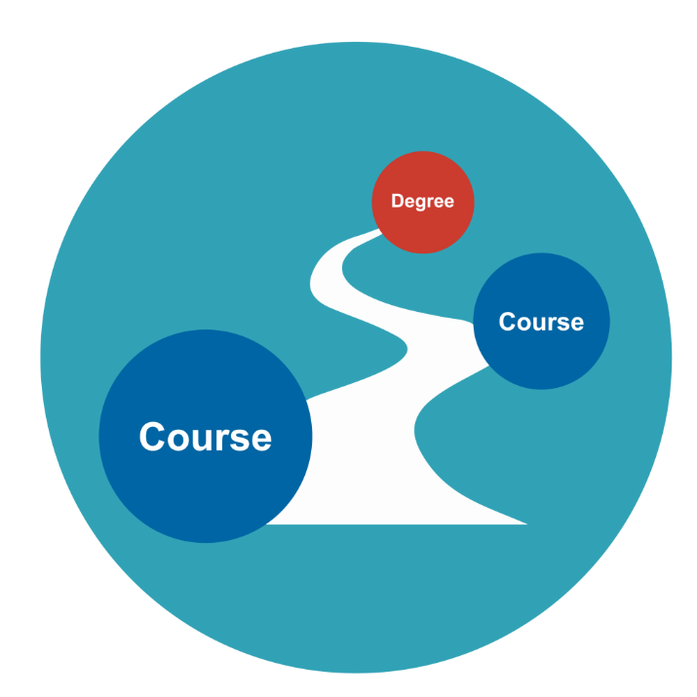
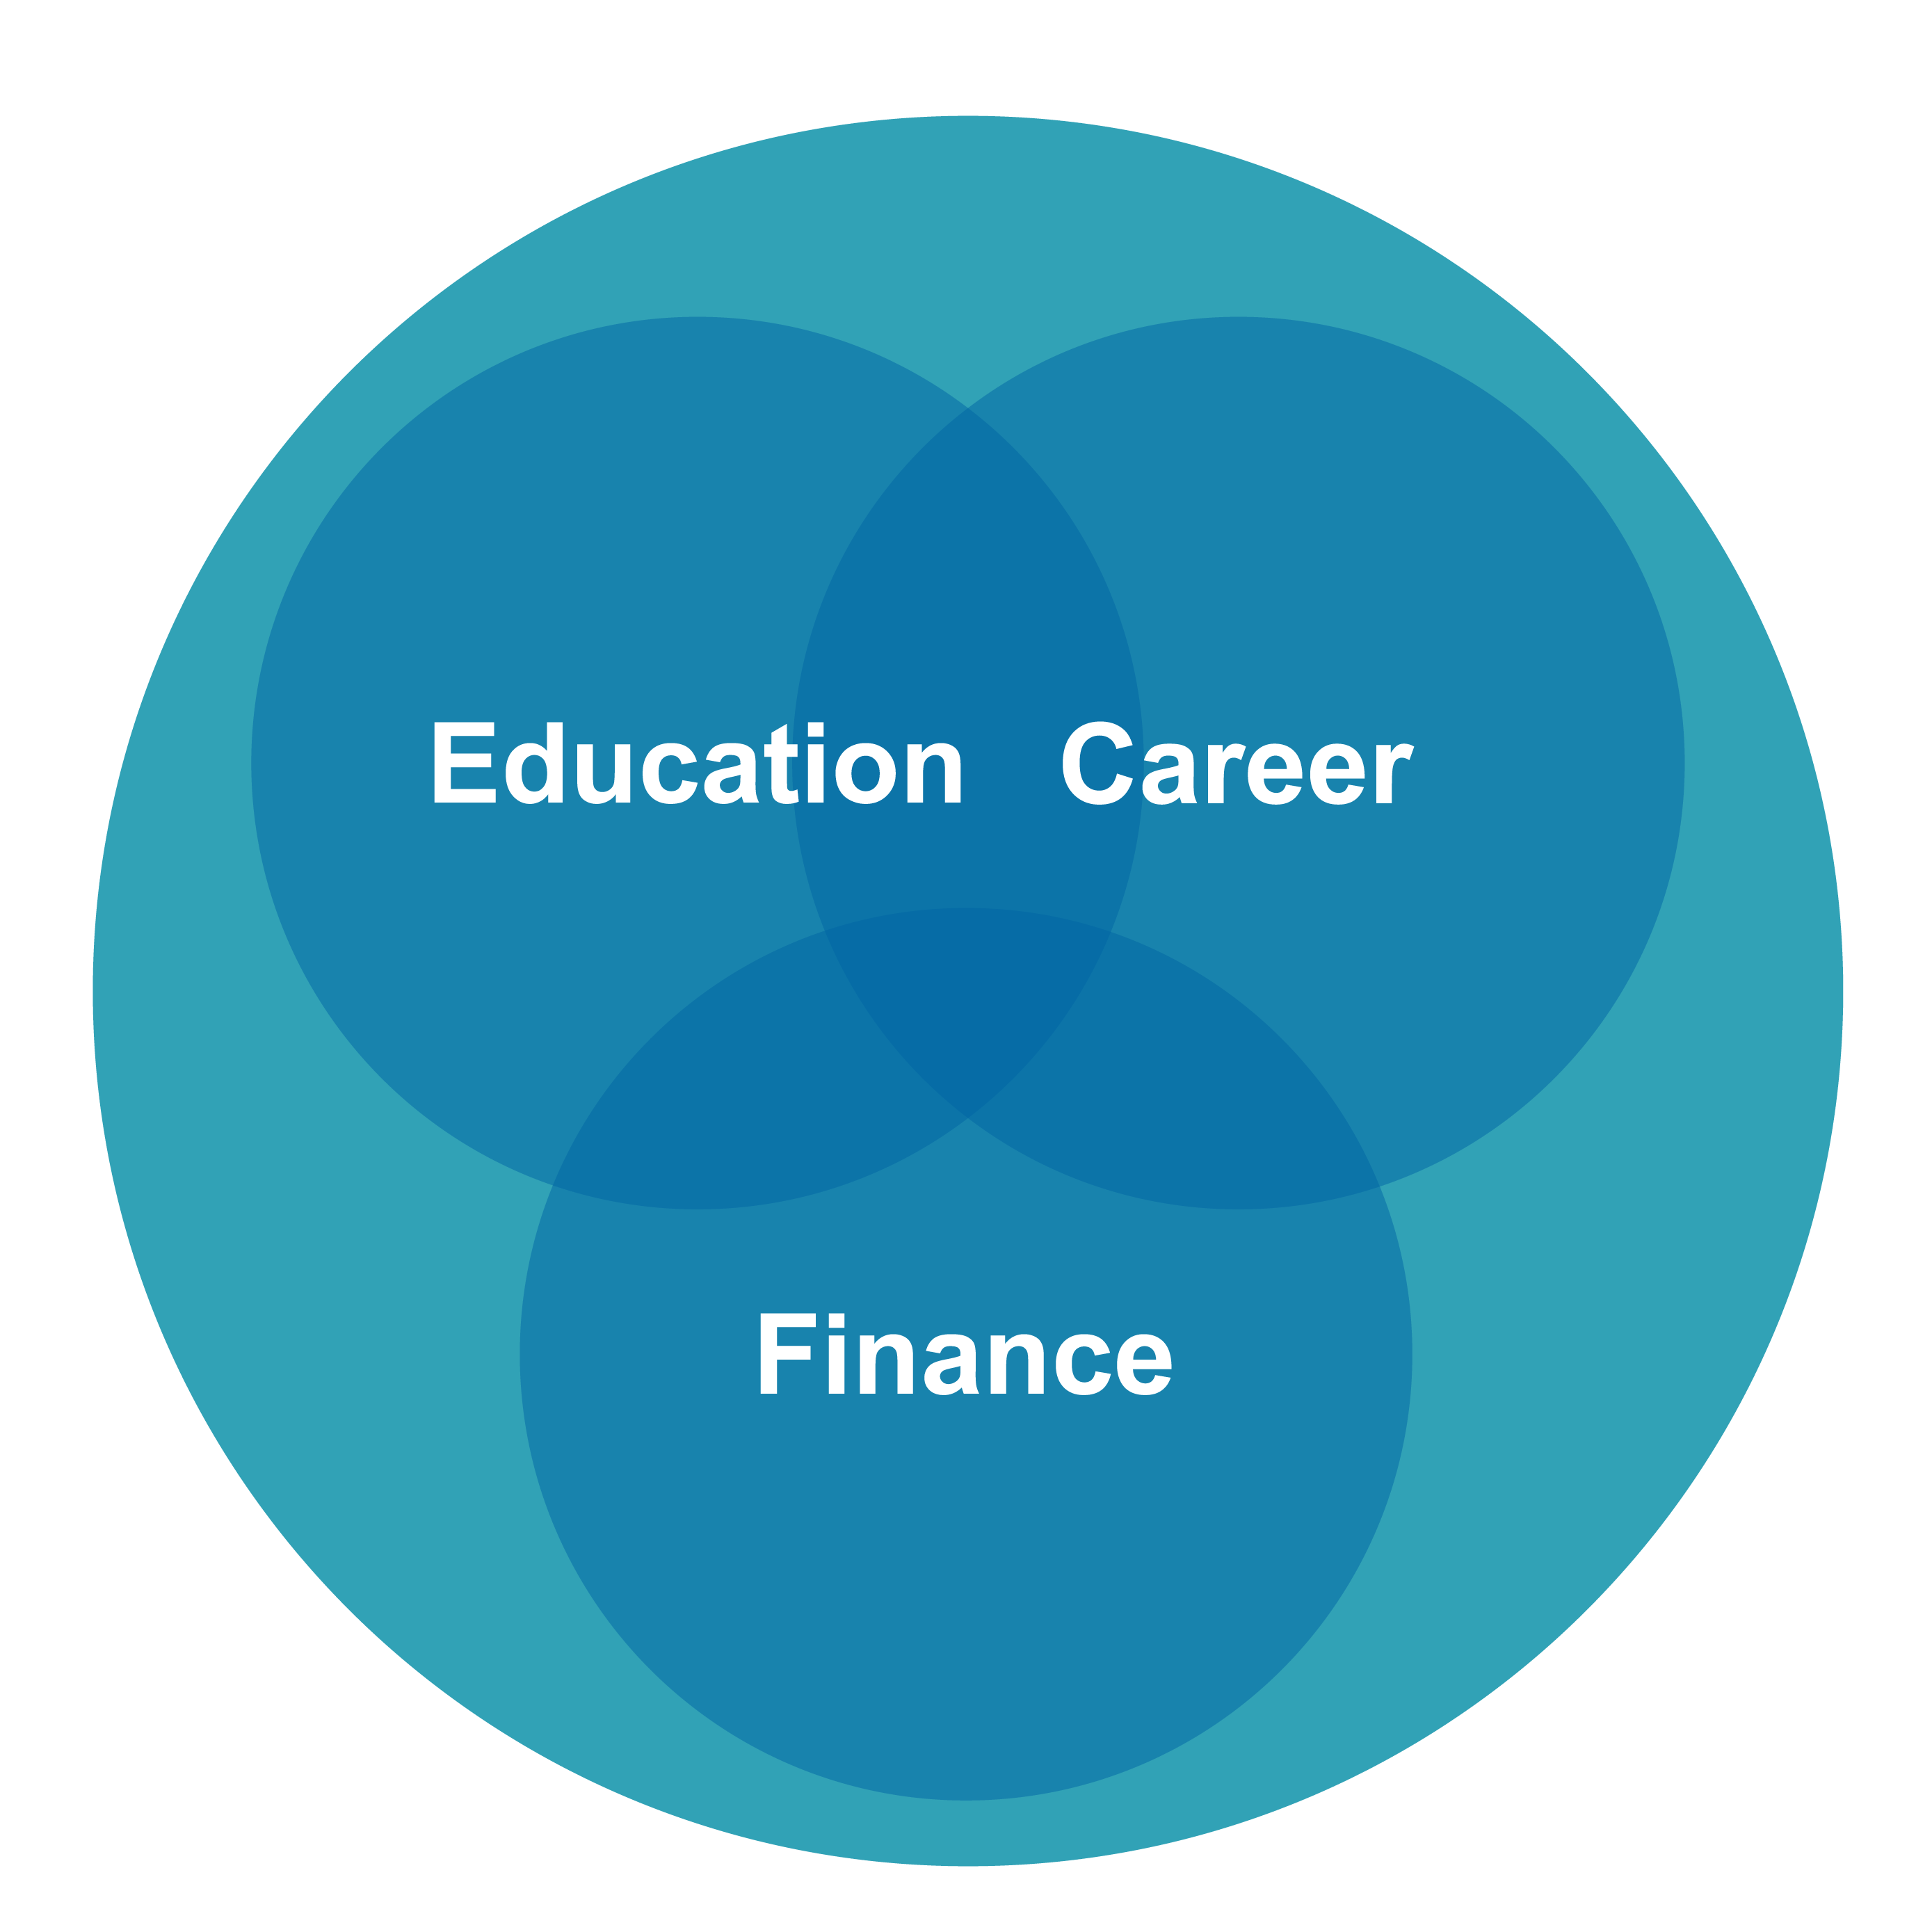
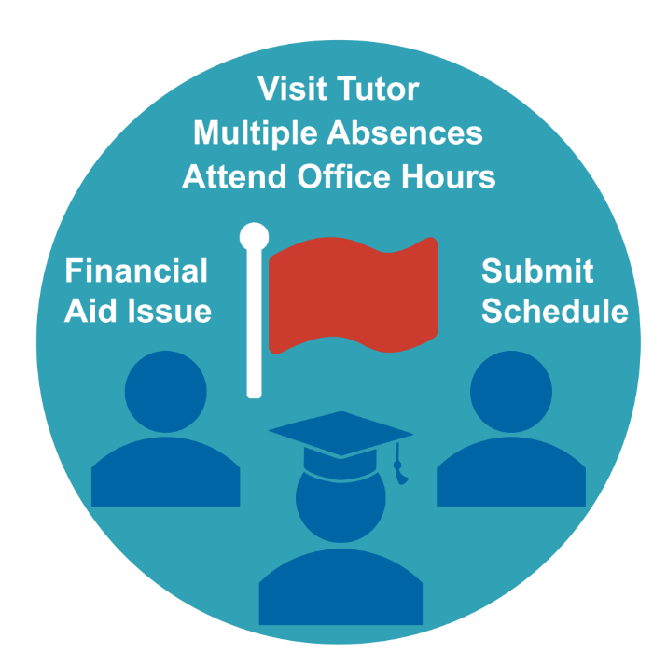
Core Technology Functions
+
+
Degree Planning
Coaching & Advising
Early Alerts & Risk Targeting

Slide 8
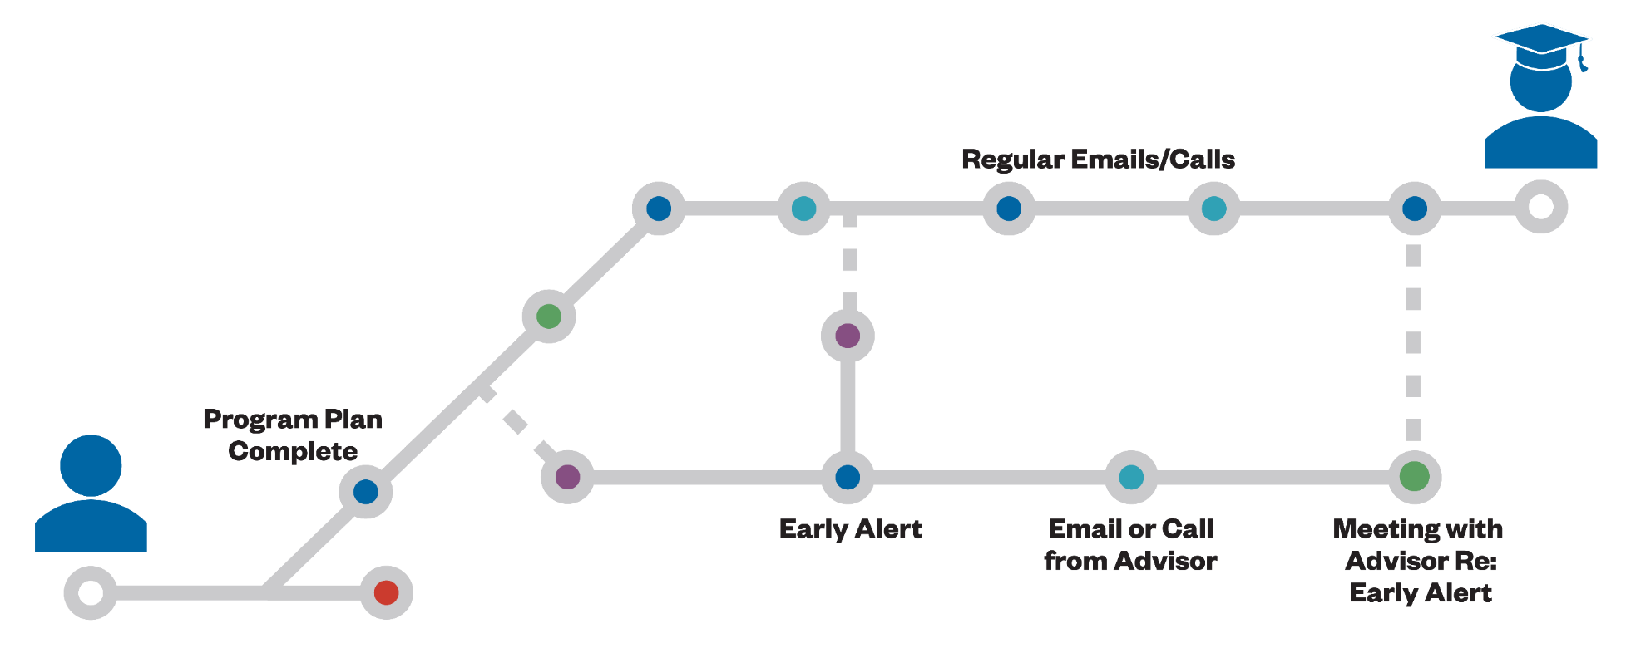
Advising Redesign Can Enable Holistic Student Support
Notes:
Ideally, these tools offer efficient delivery of information, freeing up advisor time to provide more holistic support. Can help resolve the capacity and other structural issues. Allow for TRIAGE of students.
For example, some advising technologies allow:
advisors to quickly send messages to students with links for setting up an advising appointment, making it easier to check-in with students over the course of the semester
Advisors can review early alert and predictive analytic data and REFER students exhibiting academically risky behavior to services such as tutoring; or submit the referral electronically and notify both the student and the service provider.

Slide 9
Activity: Audience Survey

Slide 10
Which aspects of technology-mediated advising reforms most interest you?
Go to menti.com
Enter code 48 37 95
Notes:
https://www.mentimeter.com/s/a2688fa41eec262e85f2b13c2b4267a7/b1d296c2d7cd/edit

Slide 11
CCRC Fieldwork and Research

Slide 12
Research Overview: 2015 - 2018
KPIs
26 institutions
Implementation Fieldwork
12 institutions
Student-unit records
In-depth interviews, focus groups, student surveys, and interviews
Institutional level implementation survey data
iPASS - RCT
3 institutions
Enhanced advising intervention
2 semesters, 2 cohorts
Support designing/ implementing the intervention

Slide 13
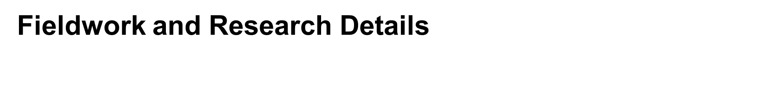
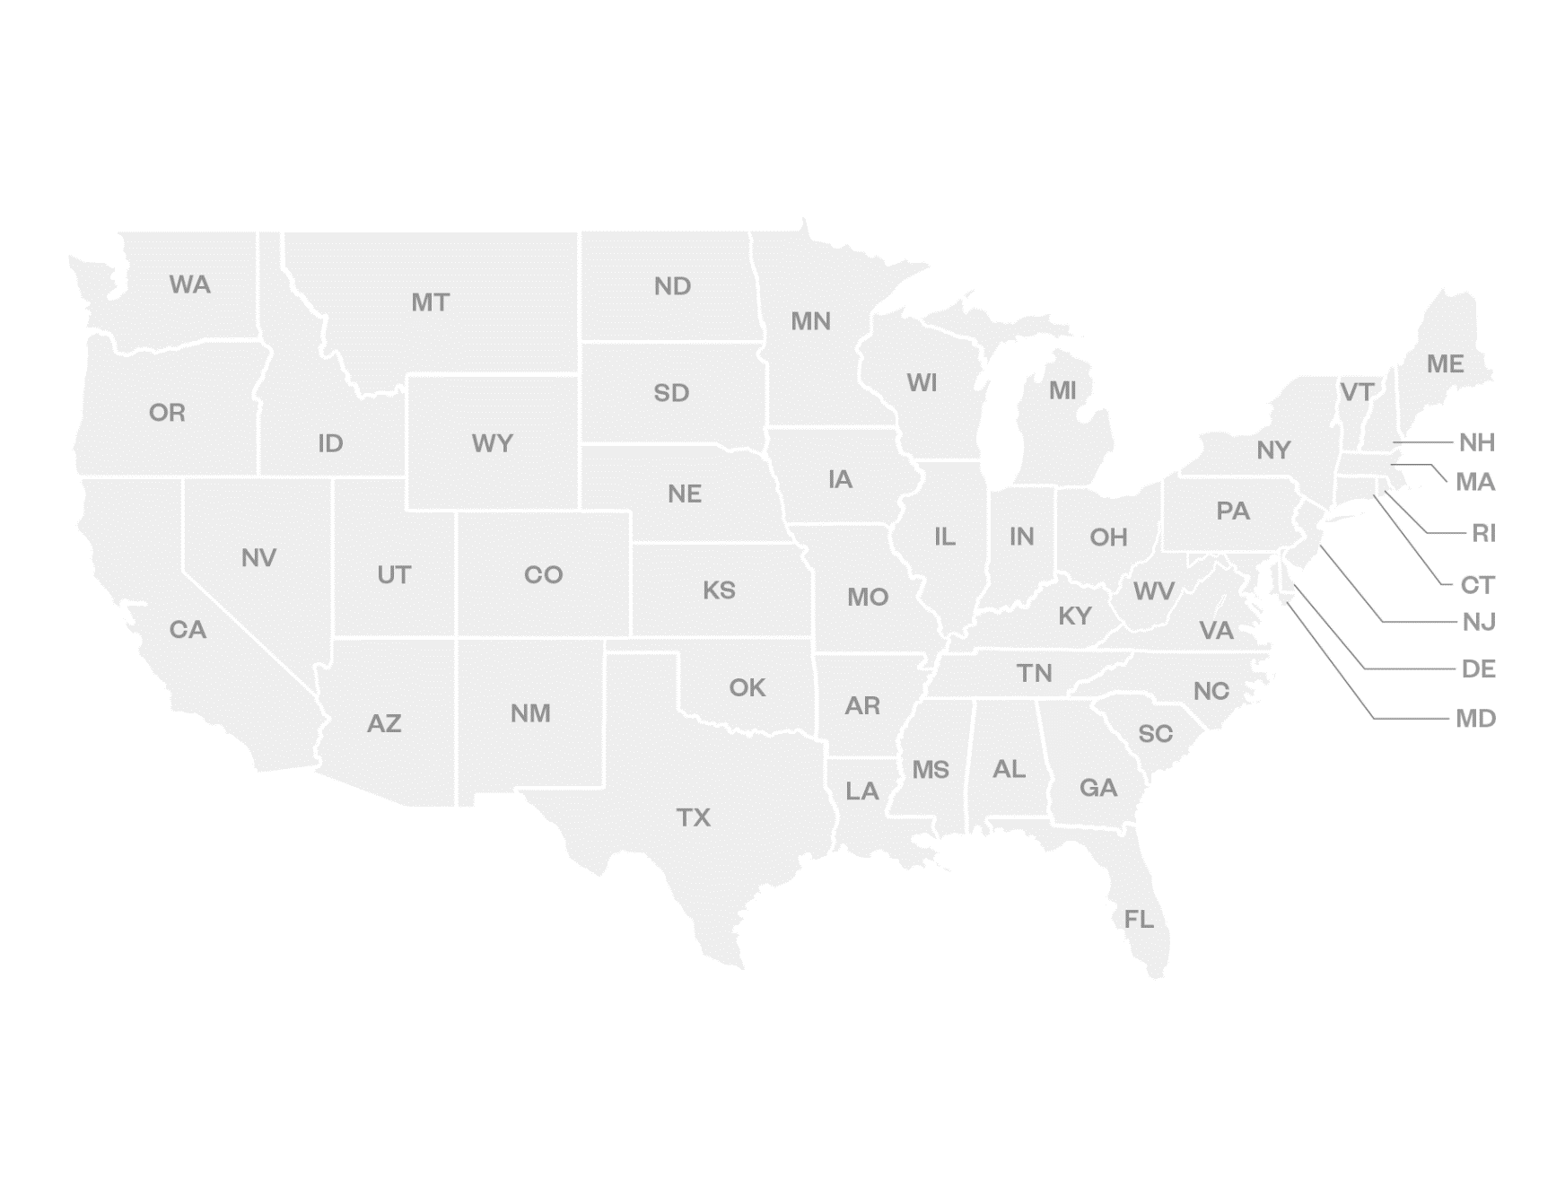
Implementation Fieldwork
  9 colleges*
  13 site visits
  266 interviews
  Advising staff, key personnel, administrators, students
RCT
  3 colleges*
  6 site visits
  231 interviews
  Advising staff, key personnel, administrators, students
38 colleges total
Hawai’i
*Community colleges and broad access universities
Notes:
IPAS 1: 2 visits to 6 community colleges (12 visits) between 2013 – 2015.

Slide 14
Qualitative Research Findings

Slide 15
Institutional Mission Focused on Student Success
…we are just using the [name of student success initiative] as our strategic planning document… So that maintains alignment…and that’s quite a bit dependent on the President as well, it really is….to set the vision and keep that alignment. We’re very well aligned here…I mean we’re all really focused on the [name of student success initiative].
- Administrator, 2016

Slide 16
Multi-tiered, Aligned Leadership
…it has to be the people that are working daily because they’re the only ones that are going to be able to understand what that’s going to look like. … I believe in [project leader] wholeheartedly that he can kind of be that intermediary. … It has to be kind of at that level, where it’s somebody that works on the ground that has the connection with the people that are going to see it, and also has the technical ability and the ability to communicate it to the administration, so that they can see what that means for resources.
- End user, 2015

Slide 17
Vision of Project Benefits
But he had to make sure everyone was committed to it, and not just make it one other way students could work with us, but the way they work with us. Commitment from ed services to basically [say], you are getting rid of all your paper forms. … We are redesigning it [education planning] around the whole concept that advisors can be sitting down at a computer with a student.
- Key project team member, 2015

Slide 18
Compatibility of New and Existing Technologies
Well I think that they need to see how it connects with their current computer system. Probably not all of them are like [name of] State where it is so antiquated that you can’t even speak the same language... But really figuring out how it meshes with your system and then doing some slow introductions I think.
- End user, 2015

Slide 19
Need for Understanding of Product and Vendor
We needed to know what the limitations of the system were. We were told, “Oh yeah, you know, it can do that. Oh yeah, it can do that.” And then when it came time to doing it, it couldn’t do it. And whenever we would contact them and say, “We can’t get it to do this or that,’ they would go, “Oh, yeah, well, that’s the way it is.”
- End user, 2015

Slide 20
Key Performance Indicators

Slide 21
Key Performance Indicators
Credit momentum
Credits earned
Grade point average (GPA)
Retention
Completion
Data
Administrative student-level data for the 26 iPASS colleges grantees from 2011 to fall of 2017.
Survey institutional level data documenting technology-mediated advising practices by the summer of 2017
Notes:
[Mention that these KPI come from the logic model]
We identified a list of KPIs for which we could razonable expect to be influenced by the reforms. Ideally, all of these KPIs should increase over time following implementation of iPASS reforms.
What each KPI measures
Credit momentum: % of students who attempted 15 or more credits during the first term
Credits earned: Average number of credits earned in Year 1, and % of credits attempted that were earned
Grade point average (GPA): Average first-term GPA, and Average cumulative GPA
Dev ed progression in English and math; % of students not college ready; % of students who attempted English or math dev ed in Year 1; and % of students who completed dev ed In Year 1
Gateway course progression: % of students that were required gateway courses in Year 1, % of students who attempted gateway courses in Year 1, % of students who completed gateway courses in Year 1
Retention: % of students retained after Year 1
Completion: % who completed associate degree in 100% time , % who completed associate degree in 150% time, and % who completed bachelor’s degree in 150% time
[CLICK]
We use two main sources of data:
Administrative data from each of the 26 iPASS colleges at the student level, which allows us to track each student since their college entrance.
[CLICK]
And data from an online survey CCRC administered between May 31 and July 5, 2017, to all 26 iPASS-participating institutions with the goal of documenting technology implementation practices.
We had to develop the survey, because the administrative data provides no information about when and how advising practices adapt to technology to enhanced the overall advising experience.
Furthermore, we do not know about staff, advisors or students’ usage of technology.
But, we knew this is SUPER IMPORTANT! One of our goals is to understand the relationship between technology adoption for advising and KPIs.
The survey was the approach we use to somehow distinguish institutions’ tech-mediated advising implementation progress.
The online survey was administered to an institutional officer involved in student success and technology implementation initiatives.

Slide 22
KPIs and advising redesign
Two-year institutions are making progress towards full implementation
Changes in KPIs take time, and are not to be expected
KPIs are only descriptive
Advising redesign takes time!
Notes:
[remove table of implementation index]
Two-year institutions are at varying stages in implementing technology-mediated advising redesign. However, Data at the institution level indicates they have all made progress in implementation.
Each institution has conducted technology-mediated advising implementation differently. Therefore, comparison between institutions or across time is purely descriptive

Slide 23
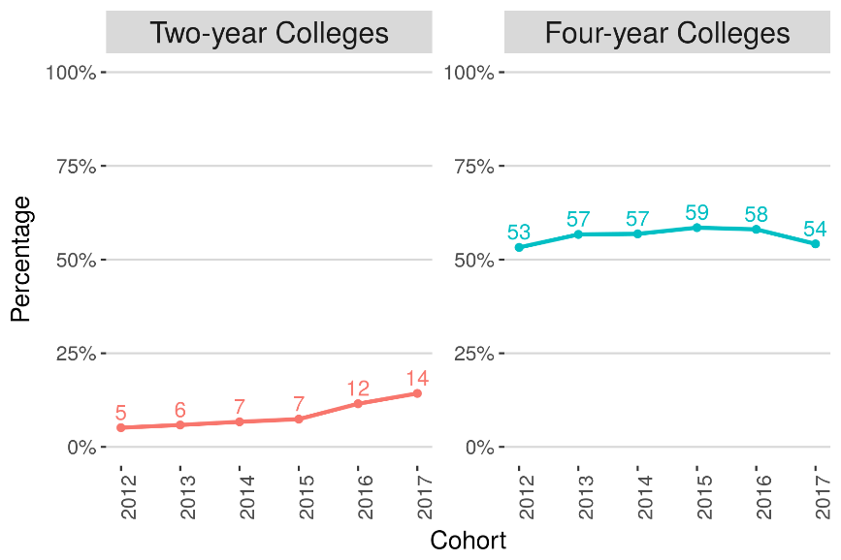
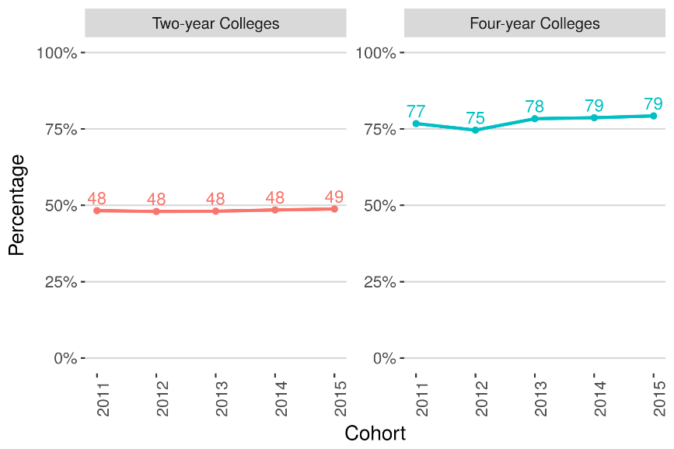
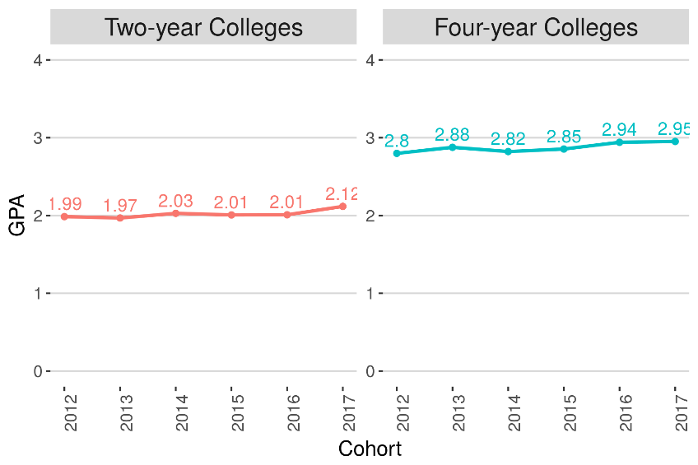
Key Findings
Figure 1. Credit Momentum (Attempting 15 credits in first term)
Figure 2. Percentage of Students Retained in Their Second Year
Figure 3. Average First-Term GPA
Notes:
Focus on short-term outcomes
Positive trends on students earning credits patterns
No changes in Retention rates
Small increasing trend in GPA
Difficult to form a narrative around these results as each institution is doing its own thing and is at different stages
Therefore, these KPI are more a descriptive overview of state of key outcomes to look at in the context of technology-mediated advising redesign.

Slide 24
Zane State College

Slide 25
About Zane State
Small community college in Appalachian southeast Ohio
East of Columbus
2,514 headcount,
  1,563 are dual enrolled high school students
62 percent Pell
31 degree programs, 11 certificate programs
Typically, ZSC are first generation
Notes:
Median household income is $32,973
21% of our student’s moms have some college or beyond and 26% of fathers have some college or beyond

Slide 26
Success Initiatives
Achieving the Dream since 2005
Completion by Design
Foundations of Excellence, John Gardner Institute
Noel-Levits: College Student Inventory
IPASS II
AACC Pathways Redesign
  Strategic Scheduling
  Advising Reform
  Dev Ed Reform
  Student Onboarding
Dash Emergency Grant
12th Grade Redesign

Slide 27
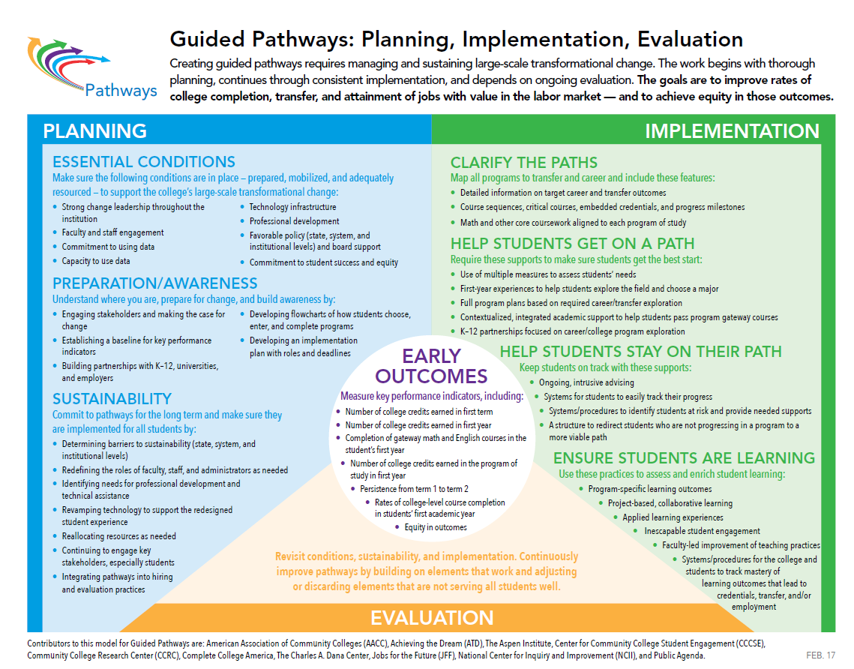
https://www.pathwaysresources.org/wp-content/uploads/2018/02/PathwaysGraphic462017.pdf
Notes:
Within the green implementation list, ZSC is engaged with each bullet point. We are at scale in some areas, and only in year 1 or 2 in others.

Slide 28
Outcomes
Notes:
We have dropped the number of credits earned at graduation from an average of 80.4 in 2012 to 71.7 in 2017.

Slide 29
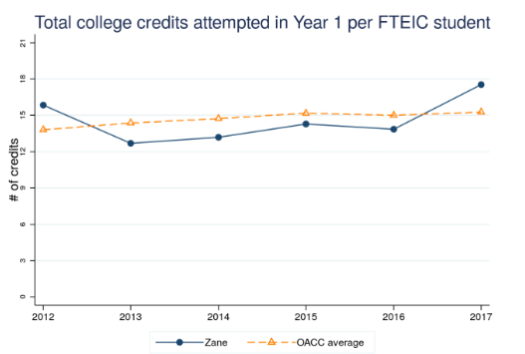
Outcomes
Notes:
2012 was our quarter to semester converstion. So from 2013 to 2016 we saw some improvements from our Completion by Design work but as we implemented our advising reforms and pathway reforms in 2017, we see a significant improvement in the total college credits attempted.

Slide 30
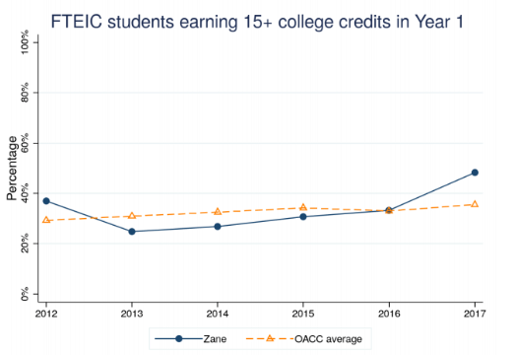
Outcomes
Notes:
We see the same for FTEIC earning 6 credits in the first term, 12 credits in the first term, 15+ credits in the first year.

Slide 31
Outcomes
Notes:
We have dropped the number of credits earned at graduation from an average of 80.4 in 2012 to 71.7 in 2017.
For the Cohort that began in 2016, their 150% completion rate is approaching 50% as they get ready to graduate this spring

Slide 32
Outcomes

Slide 33
Challenges
Culture Change
Employee Fit
Software Solution Effectiveness
Rapid Environmental Changes
  Shrinking Enrollment
  Dual Enrollment Growth
  Economic Conditions
  State Politics

Slide 34
Q & A
Notes:
Ideas for discussion topics:
How to engage students
Metrics people are using to assess student progress and effectiveness of reforms
Next frontiers for technology-mediated advising reforms

