Slide 1
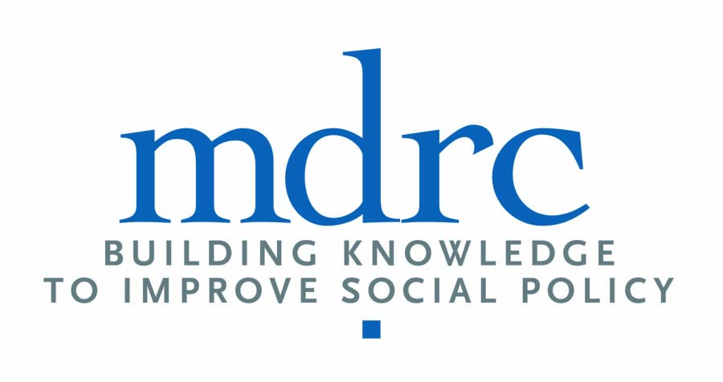
Implementing Holistic Student Support: An Introduction to Key Structures and Processes

Slide 2
What is holistic student support?

Slide 3
Holistic student support teaches students how to identify and pursue academic and life goals.
To teach students how to make these decisions, advising and support practices need to address four areas of learning and development.
Information
Skills
Cognitive Development
Affective Support
Martin, H. (2007). Constructing learning objectives for academic advising. Retrieved from NACADA Clearinghouse of Academic Advising Resources website: http://www.nacada.ksu.edu/Resources/Clearinghouse/View-Articles/Constructing-student-learning-outcomes.aspx
Tait, A. (2000). Planning student support for open and distance learning. Open Learning, 15(3), 287–299.

Slide 4
Holistic student support is also structured and delivered according to a SSIPP model.
Sustained
  Support is ongoing, rather than using an “inoculation” approach.
Strategic
  Services are differentiated to maximize capacity.
Integrated
  Services are not viewed as stand-alone interventions.
Proactive
Services are an integral part of all students’ experiences.
Personalized
  Students receive the support they need when they need it, from an individual who knows them well.

Slide 5



Holistic support leverages advising technology tools to transform support using SSIPP strategies.
Visit tutor
Multiple absences
Attend office hours
Degree
Education
Career
+
+
Financial
aid issue
Submit
schedule
Course
Course
Finance
Coaching & Advising
Early Alerts & Risk Targeting
Degree Planning

Slide 6
How is holistic student support implemented?

Slide 7
Framework articulates components that embody advising-as-teaching and SSIPP principles.
Structures for Student Support Practices |  | Outreach Processes |  | Advising Pedagogy
Provides guidance on how and when support is administered so that it is sustained, strategic, and proactive. |  | Outlines communication practices that extend to targeted, personalized messages and address the four areas of learning (information, skills, cognitive development, and affective support). |  | Describes day-to-day interactions between advisors and advisees to teach students in the four areas of learning.
Framework is designed to allow institutions to identify and implement the features that align with their institutional context and needs.

Slide 8
Structures for Student Support Practices
Administrative Support
Guidelines for notifying students of administrative or clerical information.
Guidelines for identifying students who have not completed administrative tasks.
Guidelines for intervening with students who have not completed administrative tasks.

Slide 9
Structures for Student Support Practices
Education Planning
Guidelines for helping students create a multisemester degree plan.
Guidelines for ensuring that all students have a complete degree plan.
Guidelines for intervening with students who do not have a complete degree plan or who make substantive changes to their degree plan without advisor support.
Guidelines for checking in with students to ensure that their degree plan still aligns with their academic and career aspirations.
Guidelines for monitoring students’ progress toward completion of program requirements.

Slide 10
Structures for Student Support Practices
Student Analytics–Risk Identification
Guidelines for determining which students are considered at-risk and why.
Guidelines for checking early-alert notifications to see which students are at-risk.
Guidelines for providing actionable predictive analytic data to advisors or other support service staff.
Guidelines for using predictive analytic tools to see which students are identified as at-risk.

Slide 11
Structures for Student Support Practices
Student Analytics–Early Interventions
Guidelines for ensuring that all at-risk students interact with advising or other support services.
Guidelines for intervening with students when informed that they are deemed at-risk.
Guidelines for alerting students when they are at risk of falling off their degree plan.
Guidelines for differentiating intervention strategies based on risk criteria (e.g., the number of flags that students receive).

Slide 12
Structures for Student Support Practices
General Advising
Guidelines for recording advising notes.
Guidelines for ensuring that advising and other support service staff have access to up-to-date advising notes.
Guidelines for employing advising pedagogy that promotes student learning in three categories: information, skills, and cognitive development (see Martin, 2007).

Slide 13
Outreach Processes
Information
Messages to students that convey administrative information (e.g., registration dates and other deadlines).

Slide 14
Outreach Processes
Skills
Messages to students that provide general strategies for academic success (e.g., messages encouraging students to visit the tutoring or writing center).
Messages to students that provide personalized strategies for academic success (e.g., messages encouraging students to discuss their essays with the writing center for specific English courses in which they are struggling).

Slide 15
Outreach Processes
Cognitive Development
Messages to students that motivate them to reflect on their educational experiences and identify areas of potential concern (e.g., via a student self-reflection survey).

Slide 16
Outreach Processes
Affective Support
Messages to students that communicate support and encouragement, such as welcome messages at the start of the semester and congratulatory messages to students flagged as high-performing.
Messages to students that connect them to social and emotional supports as needed.

Slide 17
Advising Pedagogy
Information
Advisors who teach students where they can find administrative information (e.g., when a financial aid or scholarship application is due).

Slide 18
Advising Pedagogy
Skills
Advisors who teach students academic planning skills (e.g., how to identify course requirements for their program of study and build a course schedule for the semester).
Advisors who teach students technical skills (e.g., how to create degree plans, understand institutional policies, use the student information system[s], read a degree audit, and register for classes).
Advisors who teach students study skills (e.g., strategies for preparing for an exam).

Slide 19
Advising Pedagogy
Cognitive Development
Advisors who teach students how to think critically about their academic and career pathways and make academic and career decisions (e.g., by helping students understand how their current courses prepare them for their careers).

Slide 20
Advising Pedagogy
Affective Support
Advisors who support students to feel a greater connection to the institution (e.g., by helping students identify an institutional structure such as a club or event that may interest them).
Advisors who teach students personalized strategies for addressing social and emotional issues, including connecting students to resources that meet their specific needs.

Slide 21

For more information
Visit CCRC on the web at
http://ccrc.tc.columbia.edu
where you can download presentations, reports,
and briefs, and sign-up for news announcements.
We’re also on Facebook and Twitter.
Community College Research Center
Teachers College, Columbia University
525 West 120th Street, Box 174, New York, NY 10027
E-mail: ccrc@columbia.edu Phone: 212.678.3091
Visit MDRC on the web at
www.mdrc.org
where you can download presentations, reports,
and briefs, and sign-up for news announcements.
We’re also on Facebook and Twitter.
New York Office
16 East 34 Street New York, NY 10016
Phone: (212) 532-3200
Oakland Office
475 14th Street Suite 750 Oakland, CA 94612
Phone: (510) 663-MDRC

