Slide 1
Designing Meaningful Developmental Reform
  Presenter name, title - set in 20pt Arial Bold
    Based on material provided by the Community College Research Center, Teachers College, Columbia University
Notes:
This PowerPoint is a tool designed to help you lead discussions about developmental education reform at your college or college system. You are welcome to cut slides, add slides, or otherwise adapt it to your needs.
To change the date or add your own logo, click on “View,” select “Slide Master,” and replace the CCRC logo with your logo and/or select the date in the header of the appropriate slide in the left hand column. Note that the logo/date must be changed separately in the slide master for the black, purple, and white background slides.
To change the level of the header to the smaller or larger level, select the text you want to change, click on home tab, and click on the “increase indent list level” icon in the top menu (next to the insert bullet/number icons and above text alignment icons).
For the second-level subtitle style, click the icon with arrow pointing right once, for third-level subtitle style, click on icon with arrow pointing right twice.

Slide 2
Tension One:
Institutional Autonomy vs. System-wide Consistency

Slide 3
Autonomy Vs. Consistency
THE CASE FOR SYSTEM-WIDE CONSISTENCY
THE CASE FOR AUTONOMY
Reduces inequity and confusion for students.
Communicates consistent, clear college-ready standards to students and high schools
Common standards make it easy to track student performance across colleges & smooth the process of transfer between colleges.
No clear evidence on what developmental policy is most effective.
Colleges have flexibility to implement policies that they believe best serve their students.
Given absence of evidence on what the optimal policy is, system-wide consistency may guarantee little more than uniform implementation of ineffective policy.
Notes:
To reconcile this tension, colleges can collaborate together to create system-wide policy, as New Jersey did (see the case study in the
accompanying packet). Some questions to help guide discussion on this issue might be:
What do you think are the advantages and disadvantages of consistency vs. autonomy in developmental education policy?
At your college, what practices and policies are consistent in terms of developmental education? What practices and policies are established with greater autonomy?
Do you see a value in creating greater consistency across the college, or with other colleges in your system/state?
What are the strengths and weaknesses of the approach New Jersey took to creating a consistent approach to assessment and placement?
Who would need to be involved in order to develop a centralized policy that people at all levels of the college would feel satisfied with?

Slide 4
Tension Two:
Efficient vs. Effective Assessment

Slide 5
Efficient vs. Effective
THE CASE FOR EFFICIENT ASSESSMENT
THE CASE FOR EFFECTIVE ASSESSMENT
CCs must evaluate thousands of incoming students every year.
Computer adaptive placement tests can do this quickly and cheaply.
Tests can be administered quickly, scored by computer, and can almost instantaneously determine placement for each student.
Efficiency of computer adaptive tests goes hand in hand with high rates of failure and attrition.
Current tests are not aligned with content students need to know to pass college-level classes.
Tests are not diagnostic – do not provide information instructors can use in subsequent treatment.
Tests don’t assess non-academic competencies.
Notes:
To reconcile this tension, faculty can work together to define the skills students need to succeed in college-level courses, and develop tests that measure these skills, as the City University of New York community colleges did (see the case study in the accompanying packet). Some questions to help guide discussion on this issue might be:
If you use a single test score to place students at your college, how aware are students of the implications of this test?
Do you ever encounter students you think are under- or overplaced?
What qualities do you think predict success for your students? Are they purely academic?
In an ideal world, how would you assess incoming students? What skills and qualities would you look at?
How aligned are your college’s tests with the content students need to know in college-level classes?
Do you see value in receiving greater diagnostic information from the assessment test? Would more diagnostic information affect how you teach your classes?
If you were to re-design the placement process for your subject area, who should be involved in the process? How could you get them involved?

Slide 6
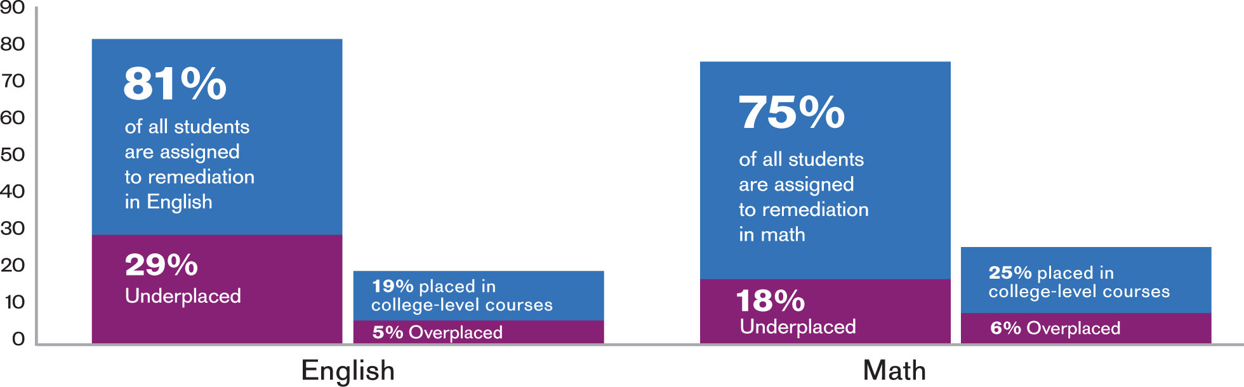
Using a Single Test Score Results in High Rates of Severe Placement Errors
Severe underplacement into developmental courses is more common than severe overplacement into college-level courses.
Notes:
Data from an analysis of a large urban community college system with higher remediation rates than the national average, Scott-Clayton, J. (2012).

Slide 7
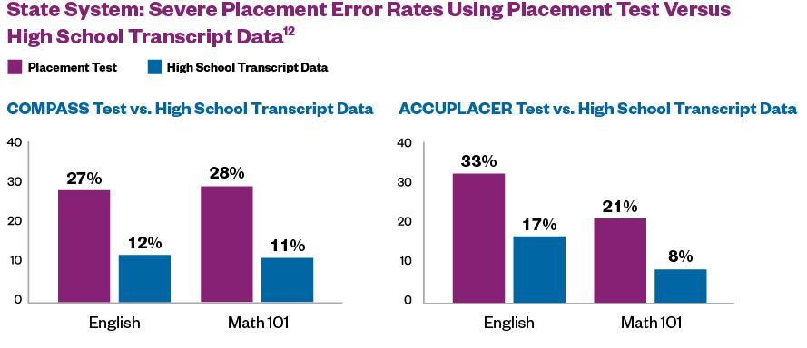
State System: Using High School GPA Could Cut Severe Error Rates in Half
Sevee Error Rates
Notes:
1Data from an analysis of a statewide community college system from Belfield, C., & Crosta, P. (2012). The colleges in the state system have the option to use either the COMPASS or ACCUPLACER tests.

Slide 8
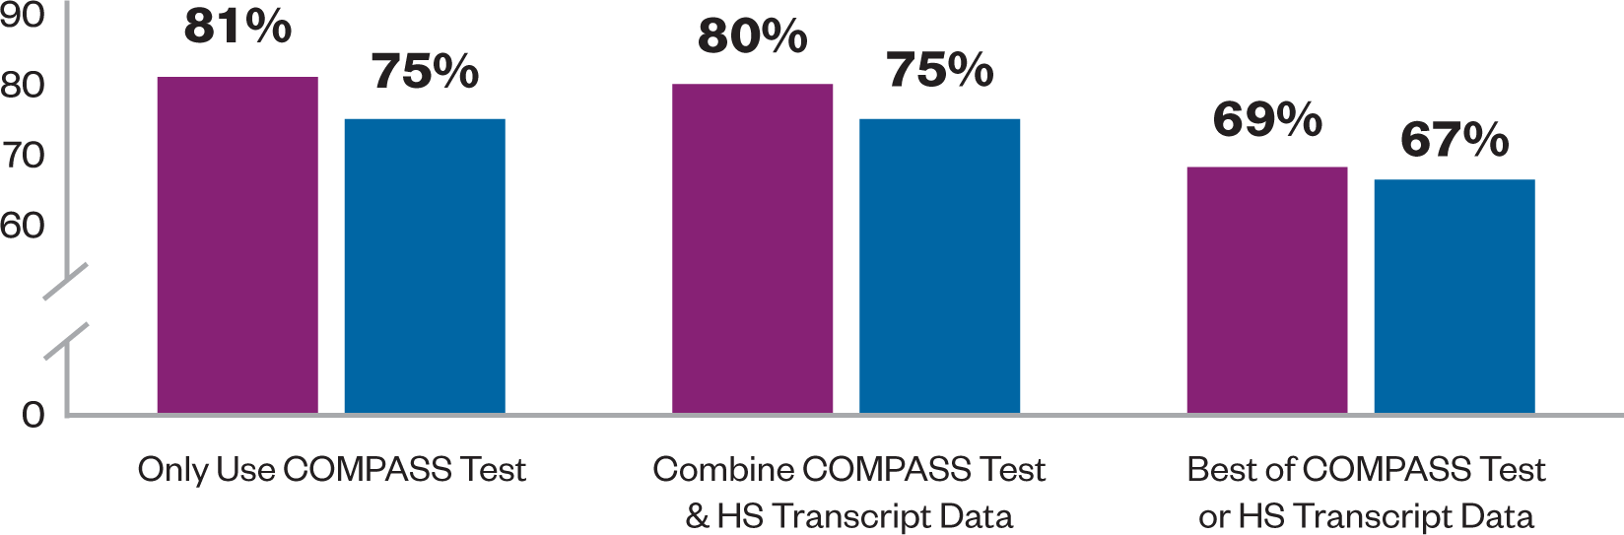
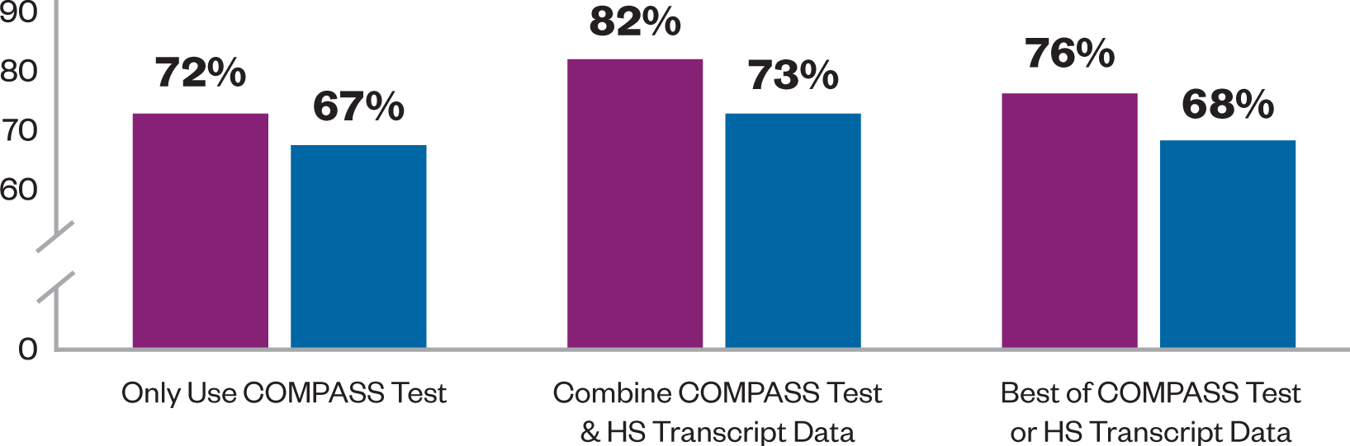
Urban System: Using High School Transcript Data Could Lower Remediation Rates While Maintaining College-Level Success Rates
Notes:
The analysis of data from the large urban community college system found that using the “best of” either high school transcript data or test scores lowered severe error rates as well as remediation rates, and increased the rates of students earning a C or better in college-level classes.
High school transcript data included high school GPA and math and English credits completed.
Scott-Clayton (2012).

Slide 9
Tension Three:
Supporting Student Progression versus Upholding Academic Standards

Slide 10
Progression vs. Standards
THE CASE FOR SUPPORTING PROGRESSION
THE CASE FOR UPHOLDING STANDARDS
National push to increase college completion hampered by high rates of remediation.
Only 28% of developmental students go on to earn a credential.
The longer the remedial sequence, the less likely students are to complete it, or enroll in and complete college-level classes.
Reforms designed to support progression may result in greater numbers of underprepared students in college-level classes.
Students may fail in a more challenging environment and drop out.
Faculty fear they will have to lower standards and/or fail large #s of students.
Value of college degree could be degraded.
Notes:
To reconcile this tension, colleges can implement compressed or accelerated developmental education pathways that have clear, faculty-defined learning goals for students, as Chabot College did (see case study in accompanying packet).
Some questions to help guide discussion on this issue might be:
Does the Chabot case study suggest any ways you could resolve this tension at your college?
Do you think it would be valuable to meet with colleagues to define learning goals for your department?
How would you go about establishing and measuring learning goals?

Slide 11
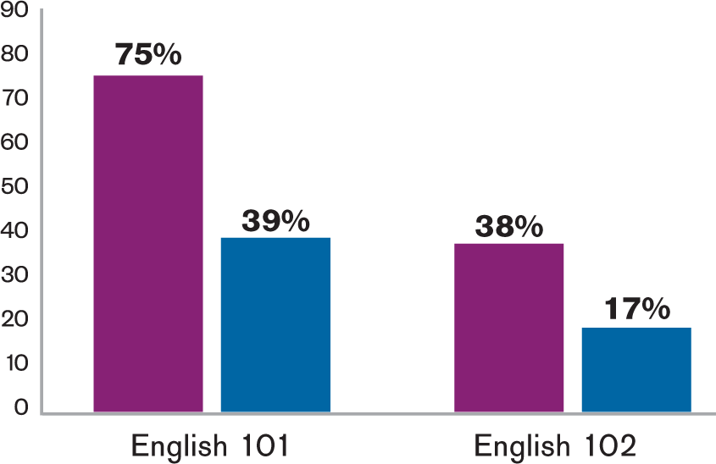
Acceleration Models May Improve Developmental Student Progression
CCBC-ALP 3-year outcomes demonstrate significantly higher rates of completion in first and second college-level composition classes.
Enroll and Pass Rates
Notes:
The Accelerated Learning Program was created at the Community College of Baltimore County. The program places upper-level developmental English students into the first college-level composition course and requires them to co-enroll in a support section taught by the same instructor.
This completion chart shows the percentage of students who ENROLL in and PASS the course within three years. Students who do not enroll within 3 years are treated as non-completers.
Charts derived from Cho, S.W., Kopko, E., Jenkins, D., & Jaggars, S. S. (2012).

Slide 12
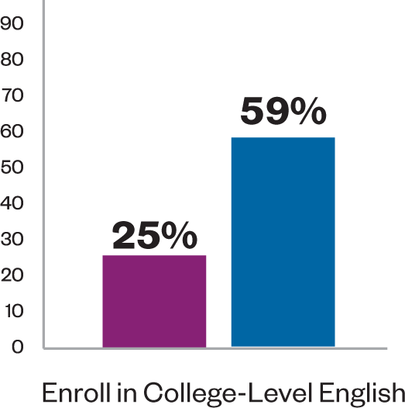
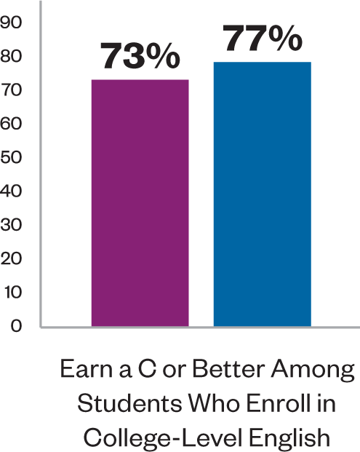
High-Quality Acceleration Maintains Pass Rates in College-Level Classes
Chabot College’s accelerated pathway raises English college-level enrollment AND accelerated students are equally likely to pass college-level English.
Notes:
Chabot College offers two developmental pathways to students. The traditional pathway consists of two semesters of developmental English. The accelerated pathway consists of one semester of developmental English. Students are permitted to self-place into the accelerated or traditional pathway.
The above pass rates are only for students who enroll in college-level English. When looking at outcome data for all developmental English students (those who don’t enroll in college-level English counting as non-passers), the rates for earning a C or better are 18% for non-accelerated students versus 45% for accelerated students.
Charts derived from Edgecombe, N., Xu, D., Barragan, M., & Jaggars, S. S. (2012).

Slide 13
References
Belfield, C., & Crosta, P. M. (2012). Predicting success in college: The importance of placement tests and high school transcripts (CCRC Working Paper No. 42). New York, NY: Columbia University, Teachers College, Community College Research Center.
Cho, S. W., Kopko, E., Jenkins, D., & Jaggars, S. S. (2012). New evidence of success for community college remedial English students: Tracking the outcomes of students in the Accelerated Learning Program (ALP). New York, NY: Columbia University, Teachers College, Community College Research Center.
Edgecombe, N., Xu, D., Barragan, M., & Jaggars, S. S. (2012). Analysis of Chabot College’s accelerated developmental English course. New York, NY: Columbia University, Teachers College, Community College Research Center. Manuscript in preparation.
Scott-Clayton, J. (2012). Do high-stakes placement exams predict college success? (CCRC Working Paper No. 41). New York, NY: Columbia University, Teachers College, Community College Research Center.

Slide 14
For more information
Please visit us on the web at
http://ccrc.tc.columbia.edu
where you can download presentations, reports,
and briefs, and sign-up for news announcements.
We’re also on Facebook and Twitter.
Community College Research Center
Teachers College, Columbia University
525 West 120th Street, Box 174, New York, NY 10027
E-mail: ccrc@columbia.edu Telephone: 212.678.3091

